Slide 1
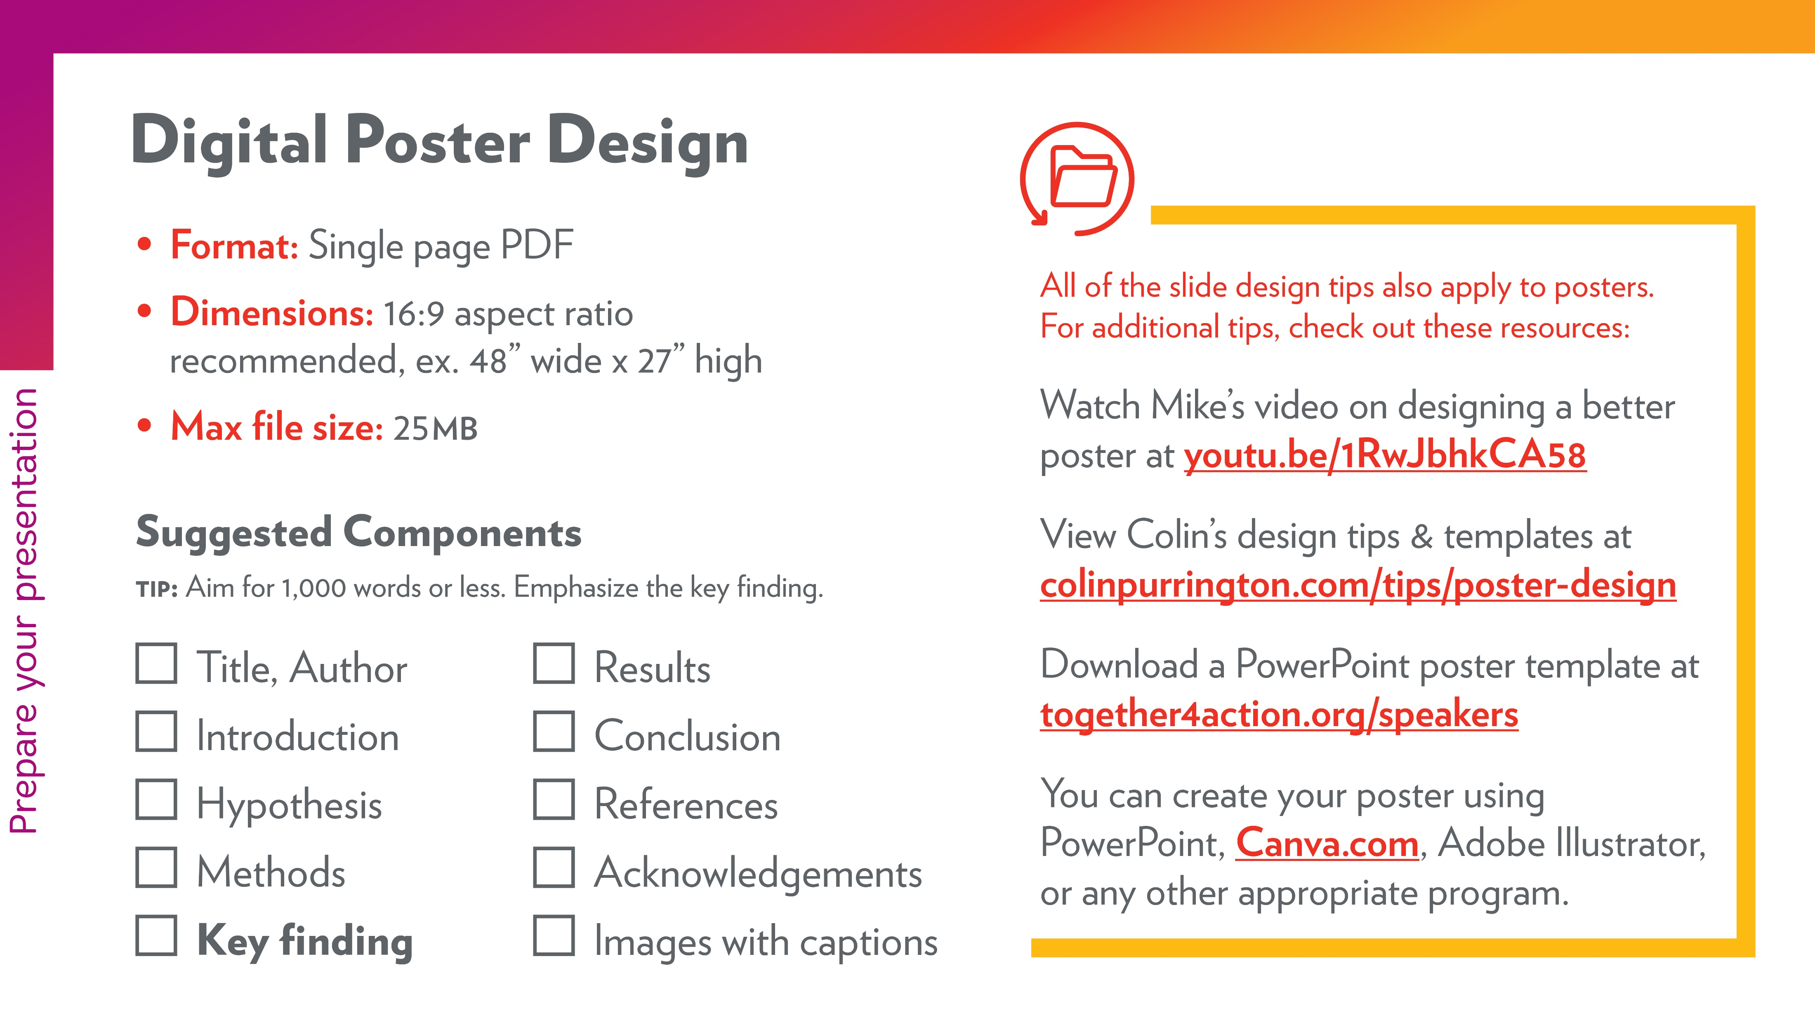
toger4action.org/poster

Slide 2
Sample Poster Layout #1
Adapted from template by Mike Morrison osf.io/ef53g

Slide 3


Key finding goes here, translated into plain English. Emphasize important words by bolding.
Non-Cognitive Predictors of Student Success:
A Predictive Validity Comparison Between Domestic and International Students
Title
Subtitle
Delete this “ammo bar” and replace it with your…
Extra Graphs
Extra Correlation tables
Extra Figures
Extra nuance that you’re worried about leaving out.
BACKGROUND: Explain why your study matters in the fastest, most brutal way possible (feel free to add graphics!).
METHODS
Collected [what] from [population]
Tested it with X process.
Illustrate your methods if you can.
Try a flowchart!
RESULTS
Graph/table with essential results only.
All the other correlations in the ammo bar.
Visualize your findings with an image, graphic, or figure.
REFERENCES:
Here
ACKNOWLEDGEMENTS:
Here
PRESENTER:
Firstname Lastname
AUTHORS:
Author 1, Author2, Author3, Author4, Author5, Author6, Author7
Notes:
Notes:
In Powerpoint, click View > Guides
Keep text within gutter guides.
Author list: Don’t split names onto two lines (e.g., “Jimmy [break] Smith”). If that happens, use a new line, unless you need the space. Bold the first names of anybody who’s presenting in person.
Intro/methods/result: Do not drop below font size 28, but if you have extra space, jack up the font size until the space is full.
Do not use color in the sidebars except in graphs/figures. It’ll pull attention from the center and slow interpretation for passersby.

Slide 4
Sample Poster Layout #2
Adapted from template by Colin Purrington colinpurrington.com/tips/poster-design

Slide 5

Title pitched at general audience that provides conclusion
or at least hints at something interesting
Firstname Lastname
Title, Affiliation
emailemailemail@aadressddress.com
LinkedIn URL
INTRODUCTION
Here
Key finding goes here, translated into plain English. Emphasize important words by bolding.
RESULTS
The goal is to enable viewers to understand the logic behind your conclusions without you needing to be there.
Don’t include every graphic you’ve made that relates to project.
CONCLUSION
Here
HYPOTHESIS
Here
METHODS
Method
Method
Method
Method
REFERENCES
Here
Visualize your findings with an image, graphic, or a key figure.
ACKNOWLEDGEMENTS
Here

